Slide 1
SSW-555: Agile Methods for Software Development
Feature Driven Development (FDD)
Instructor: Dr. Nafiseh Ghorbani
Department of Systems Engineering
Stevens Institute of Technology

Slide 2

Today's topic
- Motivation: Large Projects
- Origins of FDD
- FDD Roles
- FDD Processes
- FDD Practices
- Similarities and differences from other Agile Methods

Slide 3

Start with some interesting quotations …
"Kanban is the science of not trying to do too much at once" -- Stephen Palmer, 2012

Slide 4
Kanban principle: Focuses on limiting the number of tasks in progress at any given time.
Avoiding overload: Prevents individuals or teams from taking on too much work simultaneously.
Efficiency: Encourages completing tasks one at a time, leading to better focus and fewer errors.
Steady workflow: Helps maintain a consistent flow of work without rushing or delaying tasks.

Slide 5
Quality outcomes: Ensures higher quality by focusing on one task before moving to the next.
Continuous improvement: Teams can easily identify bottlenecks and adjust their processes for better performance.
Overall goal: The science of not trying to do too much at once leads to sustainable and manageable work processes.

Slide 6
Start with some interesting quotations …
"We try to solve the problem by rushing through the design process so that enough time is left at the end of the project to uncover the errors that were made because we rushed through the design process" -- Glenford Myers (via Jeff De Luca)

Slide 7
The quotation highlights a common pitfall in project management, especially in software development, where teams rush through the early stages (like the design process) to save time.
However, this approach often leads to mistakes that only become apparent later, which can create delays and require additional work to fix.
Rushing the design process: Teams may try to speed through initial design stages to save time, often skipping important steps or not thoroughly considering details.
Focus on saving time: The intention is to free up more time for later stages of the project, assuming that getting the design done quickly will give more time for other tasks.

Slide 8
However, this approach often leads to mistakes that only become apparent later, which can create delays and require additional work to fix.
Uncovering errors later: Because the design phase was rushed, mistakes or oversights are often not noticed until much later in the project, leading to more time spent fixing problems.
Cycle of inefficiency: This cycle can create delays and inefficiencies, as the "saved" time is spent correcting the rushed work, making the entire project take longer than if the design process had been done more thoughtfully from the beginning.
In summary, it means that rushing the design phase to save time often backfires, requiring more time later to fix errors that could have been avoided with a more thoughtful approach upfront.

Slide 9
Start with some interesting quotations …
"Agile software development is about iteration not oscillation" -- Jim Highsmith (paraphrased), Agile 2009

Slide 10
Iteration:
In Agile, work is done in small, manageable chunks or "iterations" (often called sprints).
Each iteration builds upon the previous one, continuously improving and refining the product.
The focus is on making steady progress with clear goals and tangible results at the end of each iteration.
Oscillation:
Oscillation refers to back-and-forth movement or indecision.
In this context, it suggests a process of repeatedly revisiting and changing decisions without making consistent progress or reaching final conclusions.

Slide 11
Meaning:
The quote means that Agile development emphasizes steady, purposeful progress through repeated, focused cycles (iterations) rather than constant back-and-forth changes or indecisiveness (oscillation).
It stresses the importance of continuous, incremental improvement and avoiding the trap of endless revisions without moving forward.

Slide 12
What is FDD?
FDD is an agile methodology that:
Breaks the system into small, client-valued features
Develops software in short, iterative cycles
Focuses on design and building by feature

Slide 13
What is COCOMO?
COCOMO estimates in FDD (Feature-Driven Development) refer to using the COCOMO (Constructive Cost Model) to estimate effort, cost, and schedule within Feature-Driven Development (FDD) agile context.
COCOMO is a traditional software estimation model that:
Estimates effort (person-months)
Predicts development time
Calculates cost based on project size (usually in lines of code) and other factors

Slide 14
Motivation: Some Cocomo estimates
So far, we’ve looked at applying Agile Methods to relatively small projects.
How do we scale Agile Methods to larger projects?
Many more developers working much longer times.
Techniques we’ve discussed so far won’t work for very large projects.
KLOC | Effort (Staff Months) | Calendar Months | Software Construction Staff Months | Software Construction Calendar Months | #Staff
1 | 0.5 | 2 | 0.4 | 1.2 | 0.3
10 | 5.8 | 4.4 | 4.4 | 2.7 | 1.6
100 | 64.2 | 9.7 | 48.8 | 6 | 8.1
1,000 | 708.4 | 21.3 | 538.4 | 13.3 | 40.4
10,000 | 7815.5 | 47.1 | 5939.7 | 29.4 | 201.7

Slide 15
Motivation: Some Cocomo estimates
In software development, KLOC stands for Kilo Lines of Code.
It's a unit of measurement that represents the number of lines of code in a software program, with one KLOC equal to 1,000 lines of code.
In the context of COCOMO (COnstructive COst MOdel) estimates, KLOC is often used to estimate the size of a project based on the number of lines of code,
Which can then be used to predict various project attributes such as effort, time, and cost.
When you're looking at a table in COCOMO estimates, the KLOC column is likely referring to the estimated or actual number of lines of code (in thousands) in a project,
Which is a key factor in making the cost and effort estimates.

Slide 16
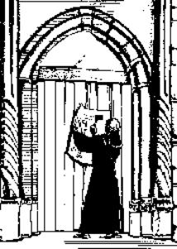
Agile Manifesto (2001)
We are uncovering better ways of developing software by doing it and helping others do it
Through this work we have come to value:
Individuals and interactions over processes and tools.
Working software over comprehensive documentation.
Customer collaboration over contract negotiation.
Responding to change over following a plan.
That is, while there is value in the items on the right, we value the items on the left more.

Slide 17
FDD’s view on the Agile Manifesto
Individuals and interactions over processes and tools.
Focus on people: Agile values collaboration, creativity, and communication among team members over rigid processes or tools.
Collaboration is key: Open, face-to-face interactions help teams respond to changes and solve problems efficiently.
Adaptability: Tools and processes should be flexible and adjusted to support the team’s needs, not dictate the work.
Empowerment: Teams are encouraged to make decisions and solve issues together, rather than relying on predefined rules or tools.
In short, Agile emphasizes the importance of people working together effectively rather than strictly following processes or tools.

Slide 18
FDD’s view on the Agile Manifesto
Working software over comprehensive documentation.
Priority on delivering value: Focus on creating working software that provides value rather than spending too much time on extensive documentation.
Essential documentation: Keep documentation minimal and only as necessary to support the software and users.
Faster delivery: Reducing time spent on documentation allows quicker delivery of working features for feedback and improvement.
Iterative approach: Documentation is updated as the software evolves, keeping it relevant and focused on current needs.
Customer feedback: Working software is presented early to gather feedback and make adjustments, rather than waiting for complete documentation.
doesn’t mean you shouldn’t write documentation
instead, documentation is important and required
but documentation without working code is a path to failure
In short, Agile emphasizes delivering functional software quickly and efficiently, with just enough documentation to support it.

Slide 19
FDD’s view on the Agile Manifesto
Customer collaboration over contract negotiation.
Ongoing collaboration: Agile values continuous communication with customers to ensure the product meets their evolving needs.
Flexibility: Focus on adapting to changes rather than being restricted by fixed contract terms.
Partnership: Agile promotes working together with customers to solve problems and deliver value.
Value delivery: The goal is to create value through collaboration, not just by fulfilling contract obligations.
In short, Agile emphasizes customer collaboration and flexibility over strict contract negotiations.

Slide 20
FDD’s view on the Agile Manifesto
Responding to change over following a plan.
Embrace change: Agile values adapting to new information and circumstances instead of sticking to a fixed plan.
Flexibility: Teams adjust their approach based on feedback and evolving needs.
Iterative process: Short cycles allow for regular adjustments after each iteration.
Customer focus: Priorities can shift to better meet customer needs.
doesn’t mean you shouldn’t plan
instead, planning is important
but you must be willing to change the plan
In short, Agile emphasizes adapting to change and continuously improving, rather than rigidly following a set plan.

Slide 21
FDD’s view on Process
A system for building systems is necessary in order to scale to larger projects
Structured framework: A repeatable process is needed to manage complexity as projects grow.
Feature focus: Breaking down projects into small, manageable features helps scale efficiently.
Clear roles: Defined responsibilities ensure accountability and coordination across teams.
Scalability: A robust system supports adding new features and managing dependencies without sacrificing quality.
Managing complexity: A system helps track progress and organize tasks as projects grow.
Effective communication: Standardized processes ensure clear communication across larger teams.
Source: pp. 273, Jim Highsmith, Agile Software Development Ecosystems

Slide 22
FDD’s view on Process
A simple, but well-defined process works best
Clear and straightforward processes ensure efficiency and focus on delivering value.
Consistency in following a simple process leads to predictable outcomes.
Faster execution and less overhead allow more time for development and quicker feature delivery.
A simple process is easier to adapt and scale as the project grows.
Source: pp. 273, Jim Highsmith, Agile Software Development Ecosystems

Slide 23
FDD’s view on Process
Process steps should be logical and their worth immediately obvious to each team member
Clear and logical steps that are easy for team members to understand and follow.
Immediate value of each step is evident, ensuring efficient progress.
Promotes effective collaboration and consistent results by aligning everyone towards common goals.
Source: pp. 273, Jim Highsmith, Agile Software Development Ecosystems

Slide 24
FDD’s view on Process
“Process pride” can keep the real work from happening
Refers to the idea that an excessive focus on following processes, rules, or procedures can hinder actual productive work or the achievement of meaningful results.
"Process pride" is when individuals or teams become overly focused on the processes they are following, valuing the process itself more than the outcomes or the work that needs to be done.
This can lead to unnecessary complexity, delays, or distractions that prevent the team from addressing the actual work or solving the real problems at hand.
Source: pp. 273, Jim Highsmith, Agile Software Development Ecosystems

Slide 25
FDD’s view on Process
Good processes move to the background so team members can focus on results
Efficient processes that don’t distract from the goal of delivering features.
Teams can focus on outcomes with minimal process-related interruptions.
Reduced overhead and increased efficiency lead to faster, more effective results.
Source: pp. 273, Jim Highsmith, Agile Software Development Ecosystems

Slide 26
FDD’s view on Process
Short, iterative, feature-driven life cycles are best
Short cycles: Development is broken into small, manageable phases or iterations, allowing for quick progress and early feedback.
Iterative approach: Features are developed, tested, and improved in repeated cycles, ensuring continuous improvement and adaptation to changes.
Feature-focused: Each cycle focuses on delivering specific, valuable features, which ensures that the project always moves toward delivering functional software.
Faster delivery: Short, iterative cycles help deliver features faster, making it easier to adjust based on user feedback or new requirements.
Source: pp. 273, Jim Highsmith, Agile Software Development Ecosystems

Slide 27
FDD Origins
Developed in 1997 by Jeff DeLuca on Singapore project with help from Peter Coad and Stephen Palmer
FDD depends on strong OO modeling at start of project
Assumes overall model of the system at the beginning
OO modeling means Object-Oriented Modeling, a way of designing a software system by representing it as a collection of interacting “objects.”
In the context of Feature-Driven Development (FDD), OO modeling is done at the beginning of the project to create a clear structure of the system.

Slide 28
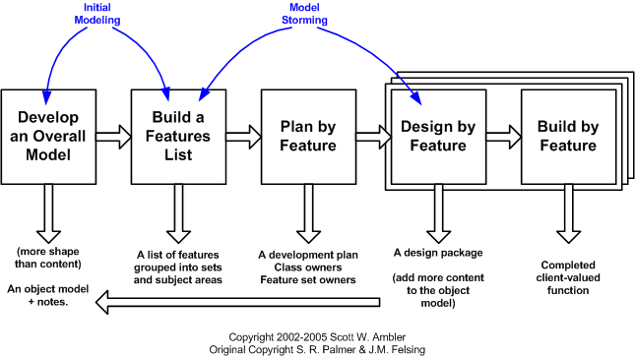
FDD Origins
Adopted short iterations to address shorter business cycles
Lightweight process specification relative to plan based methods used in the past, but heavier weight than some Agile methods

Slide 29

Singapore Project
Banking domain – lending instruments
Failed 2-year project by a "well-known systems integration firm"
3500 pages of "useless cases” (vs. use cases)
Hundreds of OO classes
Thousand of attributes
No code
Using FDD, they successfully developed 2000 features in 15 months with 50 staff
Developed initial model in 1 month
Planned features in 2 weeks

Slide 30
Singapore Project
Real-world project in Singapore during the late 1990s.
Led by Jeff DeLuca, with help from Peter Coad and Stephen Palmer.
Focused on developing a large, complex software system.
The challenges of managing complexity and scaling the development process led to the creation of Feature-Driven Development (FDD).
FDD was designed to deliver software through iterative cycles focused on small, well-defined features.
The Singapore project served as the foundation for the development of the FDD methodology.

Slide 31
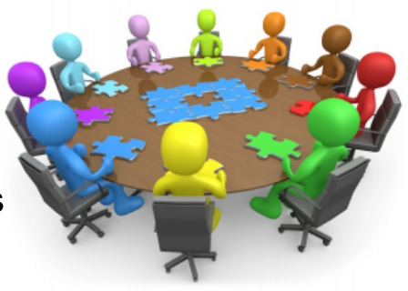
FDD Features
Cross-functional team
Focus on collaboration
Developers working closely with customers
Time boxed activity
Start project with:
Shared understanding of the project
Shared vocabulary between developers and customers
Conceptual framework
Overall Model of the system

Slide 32

Roles in FDD
Domain Experts – voice of customer
Project Manager (DeLuca) – administrative lead
Chief Architect (Coad) – responsible for overall design
Development Manager (Palmer) – team management
Chief Programmers – lead teams in design of features
Feature Teams – temporary groups of developers implementing features
Class Owners – developers who own individual classes
Different from XP’s collective code ownership

Slide 33










Teams also require …
Ability
5 FDD
Processes
Leadership
Experience
Discipline

Slide 34
The 5 FDD Processes
JEDI (Just Enough Design Initially) approach
Not BDUF (Big Design Up Front) as in Plan driven approaches
http://agilemodeling.com/essays/fdd.htm

Slide 35
General effort guidelines
Process | Initial | Ongoing
1 Develop an Overall Model | 10% | 4%
2 Build a Features List | 4% | 1%
3 Plan by Feature | 2% | 2%
4 Design by Feature | 77%
5 Build by Feature

Slide 36
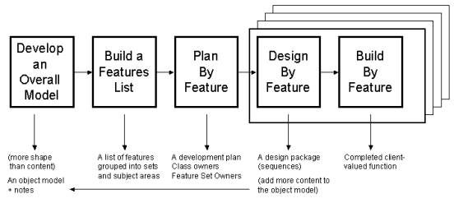
Process 1: Develop an Overall Model
1. Form the modeling team (led by Chief Architect)
Includes Domain experts, Chief Programmers
2. Perform domain walk-through
3. Study relevant documents to understand domain knowledge
4. Develop the model (led by Chief Architect)
Define overall “shape" of the model, rather than the details
More details will be added during the Design by Feature process
5. Refine the overall object model
6. Write model notes
7. Internal and external assessment

Slide 37
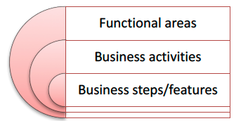
Process 2: Build a Features List
1. Form the features list team (Chief Programmers) Goal is to define all the features (product backlog)
2. Build features list – oriented to the business needs Hierarchical, not flat, like user stories
Features should be small enough to implement in 10 days
Describe each feature with the template:
<action> <result> <object>
E.g., calculate the total of a sale

Slide 38
Process 3: Plan by Feature
Goal is to create a plan to deliver all features
1. Form the planning team
(Development Manager, Chief Programmers)
2. Determine the development sequence
Some dependencies are obvious, but others are more subtle
May depend upon resource availability
3. Assign business activities to Chief Programmers
4. Assign classes to developers
Unlike XP’s collective ownership, classes are owned by individual developers

Slide 39
Process 4: Design by Feature
1. Form feature team (Chief Programmer, developers)
Dynamic team, formed for this feature
2. Domain walk-through (domain expert)
3. Study the referenced documents (team)
4. Develop the UML sequence diagrams (team)
Done as group activit
Scribe records notes
5. Refine the object model (Chief Programmer)
6. Write class and method prologues (developers)
7. Design inspection (team)

Slide 40
Process 5: Build by Feature
1. Implement classes and methods (class owner)
2. Code inspection (feature team)
3. Unit test (class owner)
4. Promote to the build (class owner with Chief Programmer)
5. Disband the team

Slide 41

FDD Practices
Domain Object Modeling
Developing by Feature
Individual Class/Code Ownership
Feature Teams
Inspections
Regular Builds
Configuration Management
Reporting / Visibility of Results

Slide 42
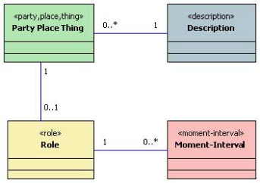
Domain object modeling
Construct class diagrams for all significant object types
Define the class names and description, but not all details
Supplement with UML sequence diagrams showing interactions between objects
Coad developed modeling in color during Singapore project to standardize class patterns

Slide 43
Developing by feature
A feature is a small, client valued function expressed in the form:
<action> <result> <object>
Examples:
Calculate the total of a sale
Assess the performance of a salesman
Validate the password of a user
Feature template provides clues to operations and classes to which they should be applied
‘Calculate the total of a sale’ suggests:
calculateTotal() operation in a Sale class
‘Assess the performance of a salesman’ suggests:
assessPerformance() operation in a Salesman class

Slide 44
Individual class/code ownership
Each class is owned by one developer
Opposite of collective ownership in XP
Advantages:
Owner maintains conceptual integrity of class
Each class has an expert associated with it
Owner can implement changes faster than anyone else
Owners can take pride in their classes
Disadvantages
Dependencies between classes (owner A needs owner B to make changes to their classes)
Risk of loss of owners during development

Slide 45
Feature Teams
Each feature is owned by a Feature Team
Team is created dynamically to design and build a feature
Disbanded after the feature is complete
Each team consists of 2-5 class owners (developers) led by a Chief Programmer
Each team contains all the owners it needs to create the feature
Everyone needed to develop the feature is on the team
Don’t depend on anyone outside the team
Owners may be on multiple feature teams at the same time
Chief programmers may also be class owners

Slide 46
Inspections
FDD inspections usually performed by feature teams on their own features
FDD suggests inspections over Pair Programming
Designs and code are inspected by team members
Advantages:
Most effective technique for discovering defects
Provide educational benefits: domain knowledge, technical skills Promotes and enforces standards

Slide 47
Regular builds
Some teams build weekly, others daily and others continuously
Advantages of regular builds:
Early detection of integration problems
Always have something to demonstrate to client, even if not doing frequent releases
Regular build process can be enhanced to:
Generate documentation
Run audit and metric scripts to highlight potential problem areas and to check for standards compliance
Run automated regression tests
Construct new build and release notes listing new features added, defects fixed

Slide 48
Configuration management
Keep code under configuration management to manage conflicts and maintain consistency
Other items kept under configuration management:
Requirements documents
Analysis and design artifacts
Test cases, test harnesses and scripts and even test results
Version of the process you are using, any changes and adjustments that may be made during the construction and maintenance of the system
Useful for audits and measuring process effectiveness

Slide 49
Reporting/visibility of results
Track by feature
Roll up summaries to feature set level
Parking lot chart for executives
Track progress with burn-up graph
Similar to burn-down graph

Slide 50
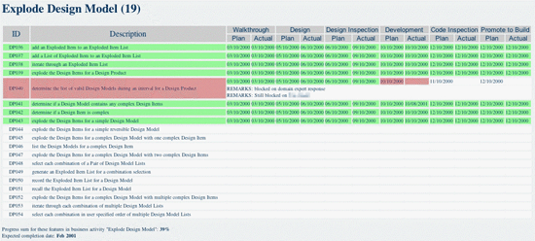
Track by feature
https://www.methodsandtools.com/archive/archive.php?id=19p3
Copyright© 1997-2004 Jeff De Luca

Slide 51
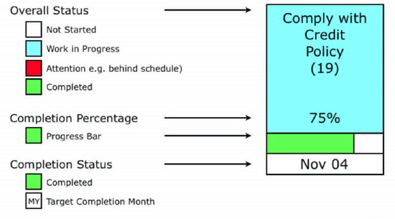
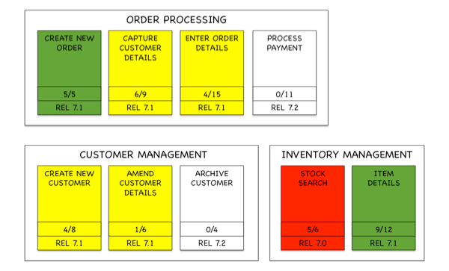
Feature set level --- Parking Lot Chart
https://www.methodsandtools.com/archive/archive.php?id=19p3
Copyright© 1997-2004 Jeff De Luca
https://insideproduct.co/parking-lot-diagram/

Slide 52
Burn up graph
A burn-up graph is a visual tool used to track progress and completion of features within a project over time.
It helps teams and stakeholders see how much work has been completed and how much is left to do, giving an overview of the project's progress toward its goals.
Key Elements of a Burn-Up Graph in FDD:
X-Axis (Time): Represents the time elapsed in the project, typically shown in days, weeks, or iterations.
Y-Axis (Work or Features): Represents the amount of work completed or the number of features that have been implemented. In FDD, this could be the number of features or feature points.
Total Scope Line: A horizontal line that represents the total number of features or work items to be completed in the project. This line remains fixed throughout the project.
Completed Work Line: This line tracks the cumulative number of features completed over time. As the team completes features, the line rises, showing progress toward the total scope.
Scope Changes (optional): In some cases, scope changes can be reflected in the graph if new features are added or removed during the project.

Slide 53
Burn up graph
How It Works:
The graph starts with the total scope of features or tasks (usually from the Feature List) plotted along the Y-axis.
As features are completed and verified, the "Completed Work" line rises over time, indicating progress.
The closer the Completed Work Line gets to the Total Scope Line, the closer the project is to completion.
Benefits of a Burn-Up Graph in FDD:
Clear Progress Tracking: Provides an easy-to-understand visual representation of how much work has been completed and how much is left.
Identifies Scope Changes: Any increases or decreases in the total scope of work are easy to spot, helping manage scope creep.
Transparency: Stakeholders can quickly understand the current status of the project, facilitating better decision-making.
Motivation: Teams can see their progress and celebrate small milestones as they work towards completing all features.

Slide 54
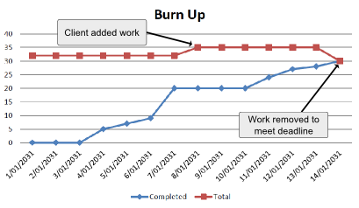
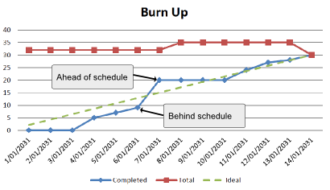
Burn up graph
https://www.clariostechnology.com/productivity/blog/whatisaburnupchart/
32

Slide 55

Similarities to other Agile Methods
Short, time-boxed iterations
Lightweight process
Requirements described as features
Customer participation in planning
but not as often, and at a higher level

Slide 56
Differences from other Agile Methods
Up-front modeling – "Just Enough Design Initially (JEDI)", to avoid refactoring
Bias toward getting it right the first time
FDD values documentation (models, notes, reference documents)
More emphasis on progress tracking and reporting
Dynamic feature teams
Chief Programmers vs developers
Design and code owned by individuals
Code inspections/peer reviews instead of pair programming

Slide 57
Differences from other Agile Methods: Scheduling features
XP/Scrum:
Customer adjusts priorities at beginning of each sprint/iteration
FDD:
Customer’s overall priorities are set early
Business activities are scheduled by the customer
Scheduled at month/year granularity
Features are scheduled by the technical team

